Slide 1
THE ULTIMATE GUIDE TO SPARK AR STUDIO
BY MUHAMMAD TALHA ALI

Slide 2

WHAT IS SPARK AR STUDIO?
Spark AR Studio is an augmented reality platform for Mac & Windows that allows you to somewhat easily create AR effects for mobile cameras. Think of it like Photoshop or Sketch, but for AR.
AR (short for “augmented reality”) isn’t a new technology — in fact, it’s been around since the 1960s! But it’s only in the last few years that AR technology has accelerated and spread across dozens of industries; today it can be found everywhere from Pokémon GO to Google Maps.
Social media is clearly riding the AR wave too, and a big part of this success is because of how hugely popular Instagram and Facebook Stories are.
According to a Facebook announcement, anyone can now create and publish their own Spark AR effects on Instagram Stories!

Slide 3
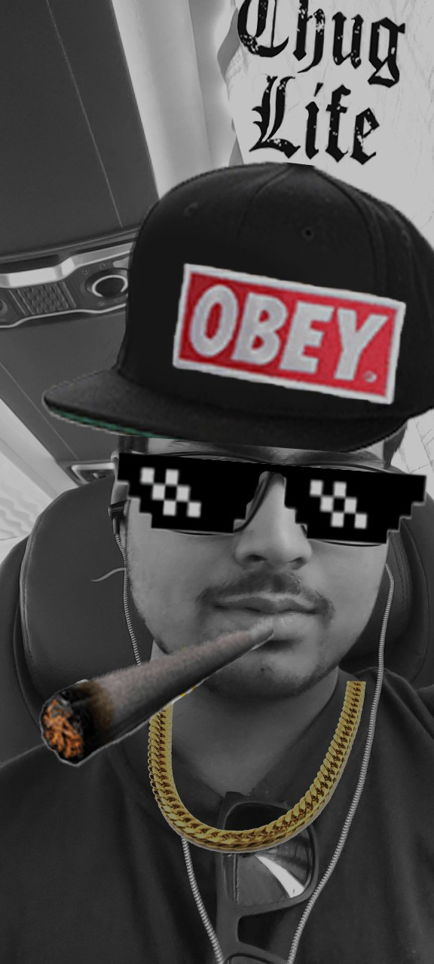
AWESOMENESS AND USES
There are many reasons why AR can be a powerful marketing tool for businesses — but one of the biggest has to do with freedom of creativity.
When it comes to AR, the world really is your oyster!
There are countless applications for the technology: cosmetics brands can use AR to let their followers virtually “try on” makeup, furniture brands can use AR to show what their products would look like in people’s homes, and fashion brands can use AR to create virtual fitting rooms, allowing people to try on shirts, sunglasses, or entire outfits to see how it fits their shape and style.

Slide 4
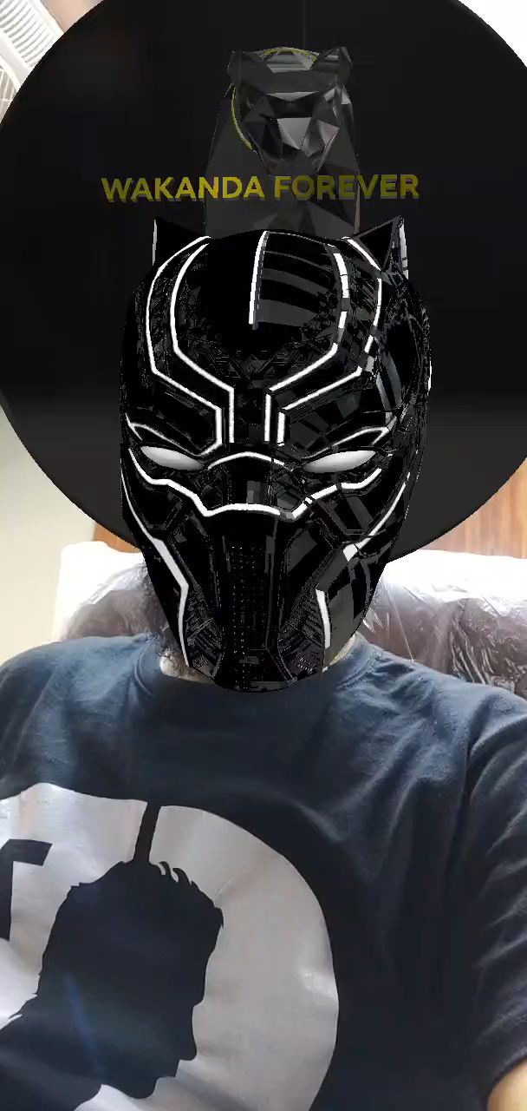
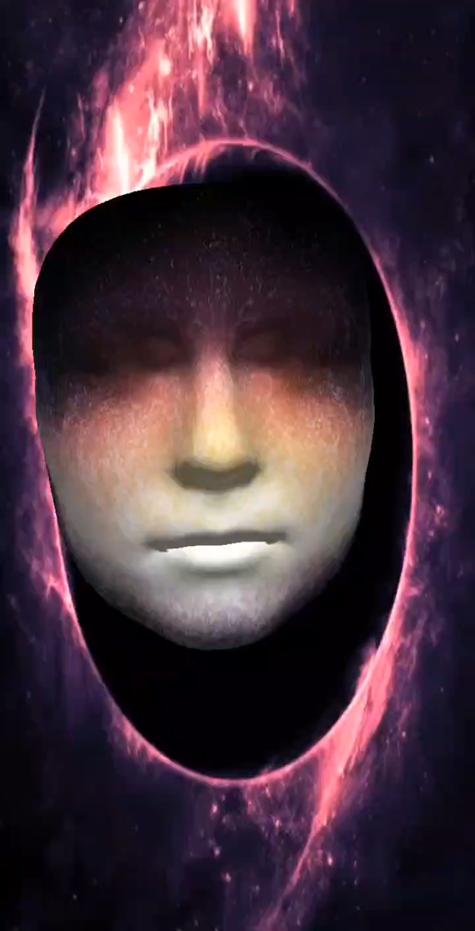

Slide 5
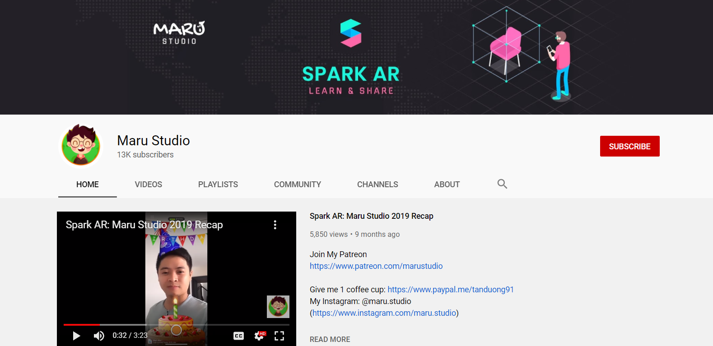
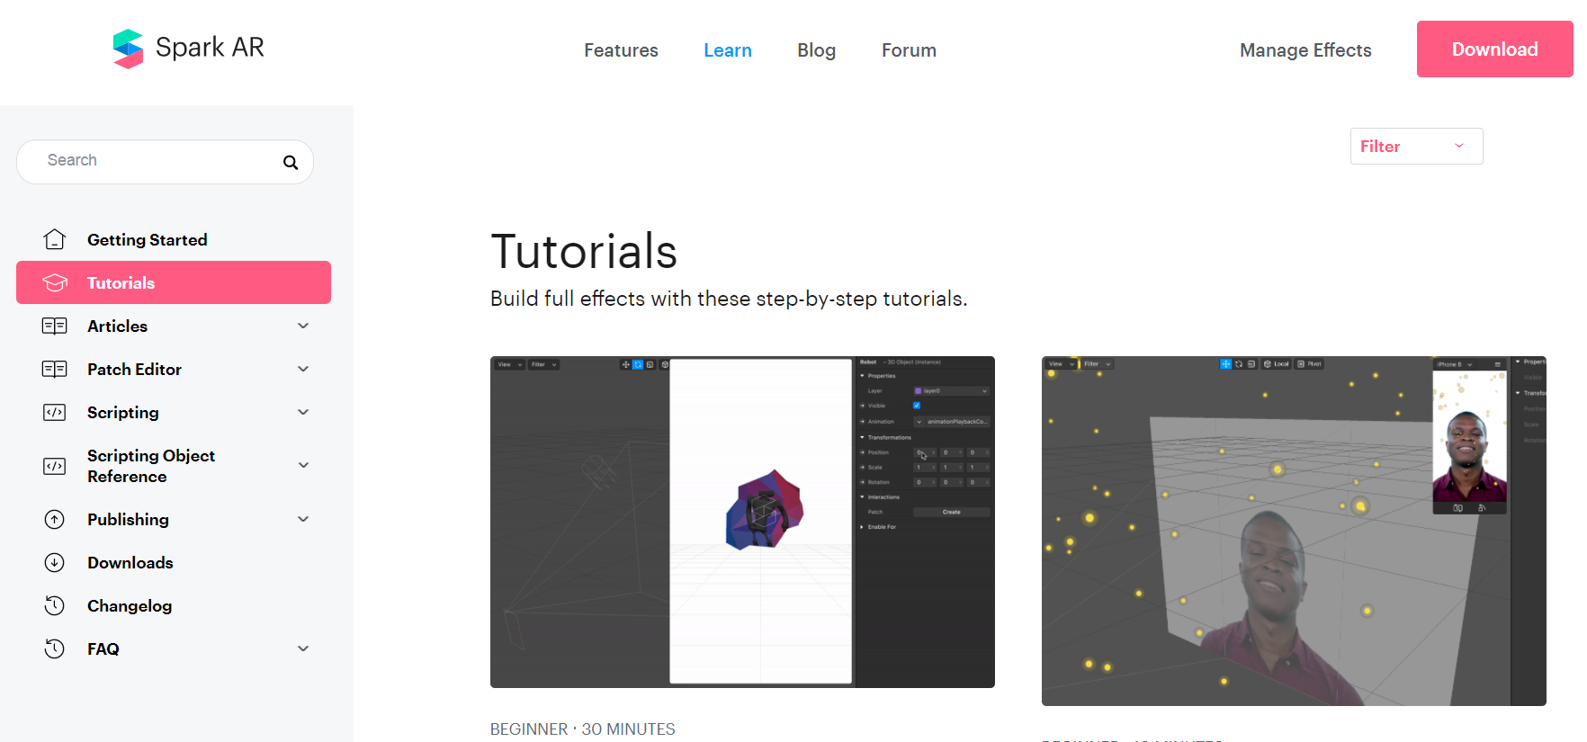
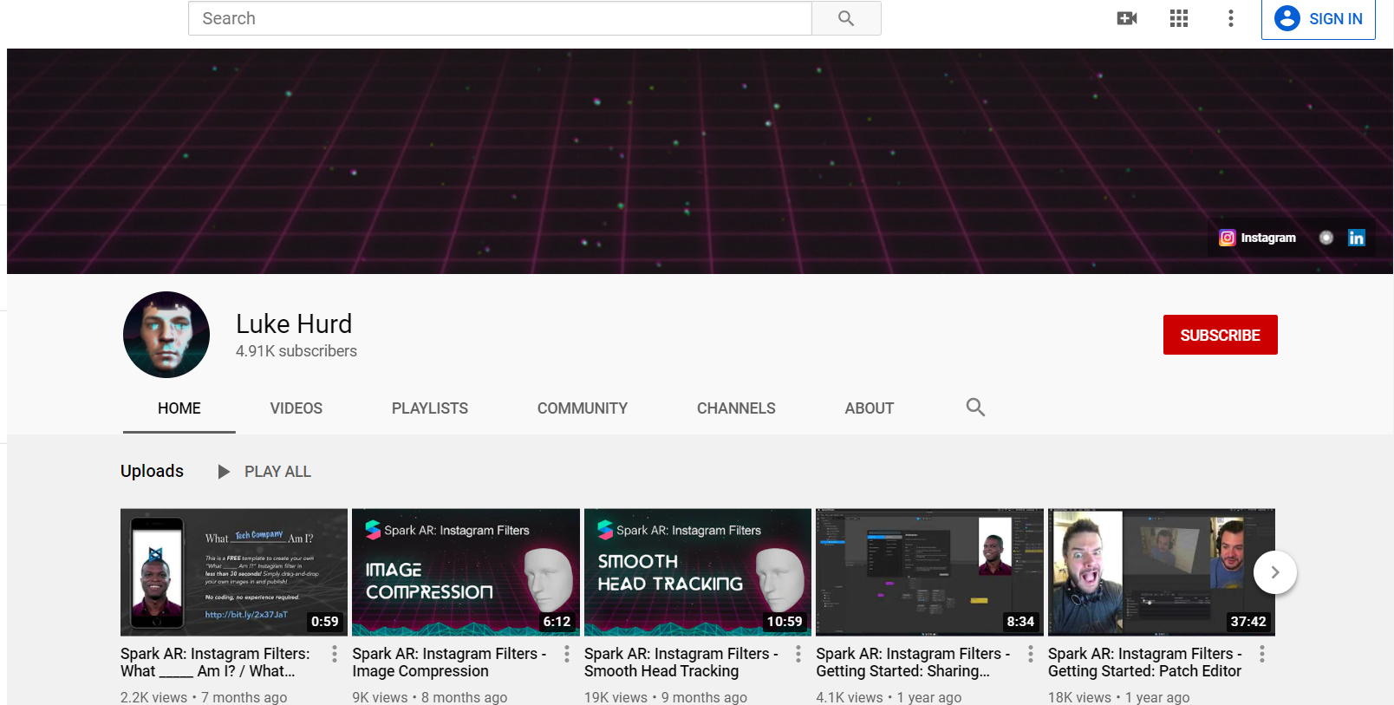
GETTING STARTED WITH SPARK AR STUDIO
https://www.youtube.com/channel/UCO6QRYjZfbYcdwwHv5vmf3Q
https://sparkar.facebook.com/ar-studio/learn/tutorials/
https://www.youtube.com/channel/UCcFy_yfaBHp2z-fceORWsWg

Slide 6
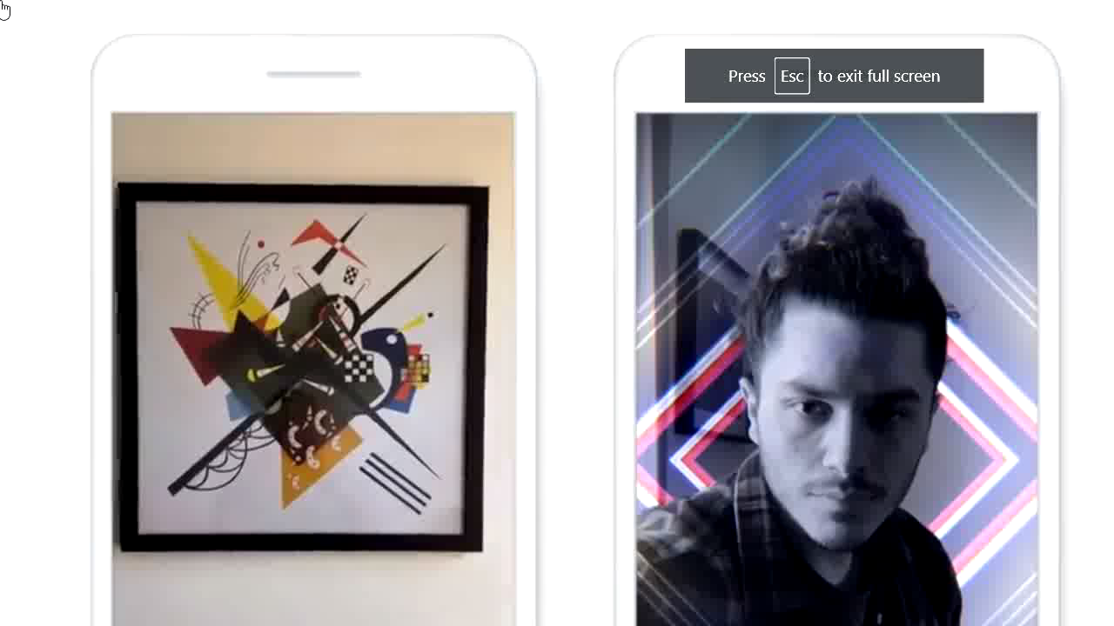
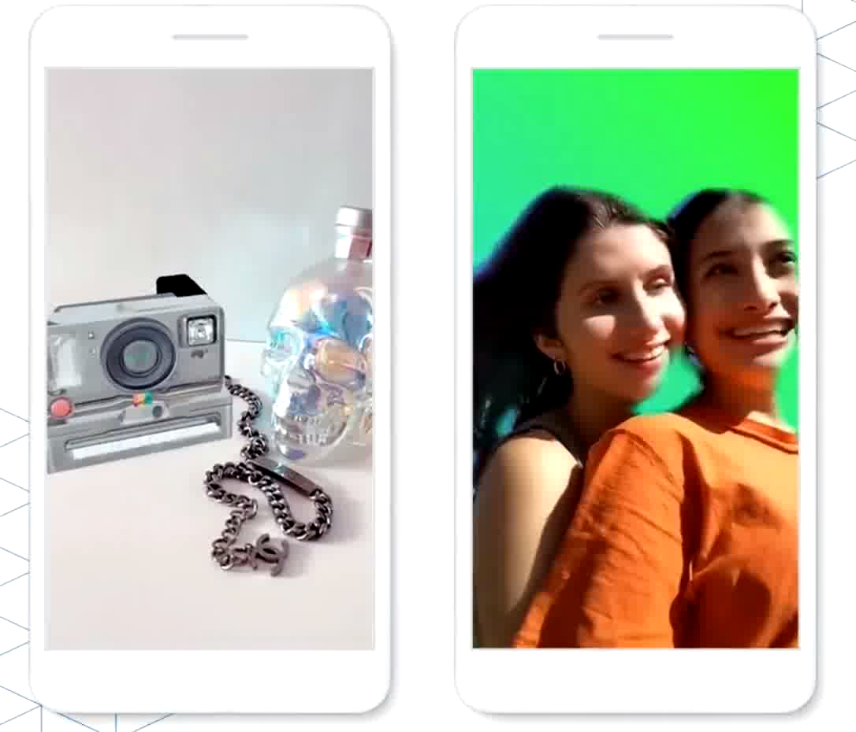
WHAT’S HOT?
AR MUSIC
1) Hair Segmentation
2) Hand Tracking
3) Render Pass
Gallery Picker

Slide 7
THANK YOU!
Mohammad Talha Ali
Email:
mohammadtalhaali97@yahoo.com
LinkedIn:
https://www.linkedin.com/in/mohammad-talha-ali-03a42016a/

